Slide 1

ShineSquad: Your On-Demand Car Wash Solution
Welcome to ShineSquad, a revolutionary platform connecting car owners with professional car washers. We are simplifying car washing, making it convenient and accessible for everyone.

Slide 2

The Problem: Inconvenient Car Washing
1
Time Constraints
2
Limited Availability
Finding time to visit a car wash can be challenging, especially with busy schedules.
Traditional car washes often have long queues and limited hours of operation.
3
Distance and Accessibility
4
Cost Concerns
Car wash prices can be expensive, especially for frequent washes.
Finding a reliable car wash in your neighborhood can be inconvenient, especially if you live in a remote area.

Slide 3
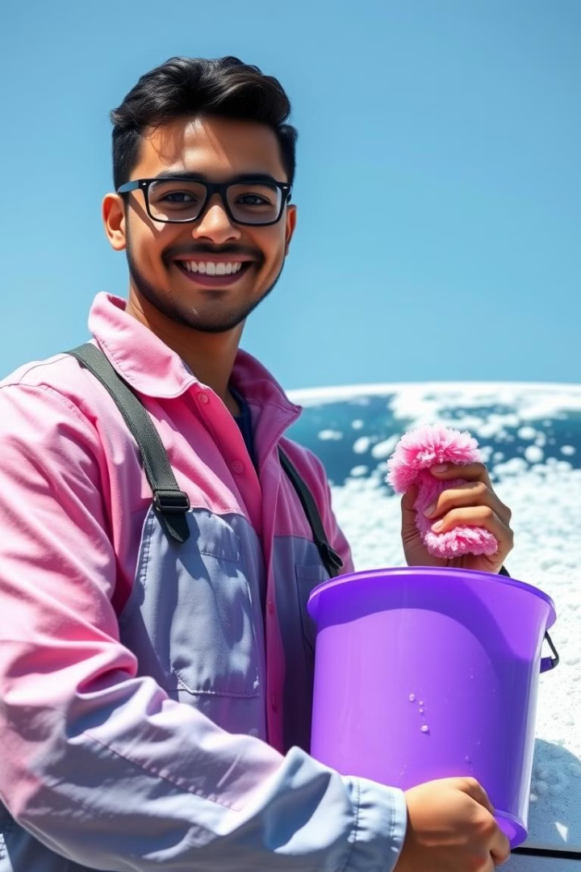
Our Solution: Doorstep Car Washing
Convenience
Flexibility
Get your car washed right at your doorstep, saving you time and effort.
Schedule a wash at your convenience, whenever and wherever you need it.
Affordability
Quality Service
Enjoy competitive prices and transparent pricing, with no hidden fees.
Experienced car washers deliver a professional and thorough clean, leaving your car sparkling.

Slide 4
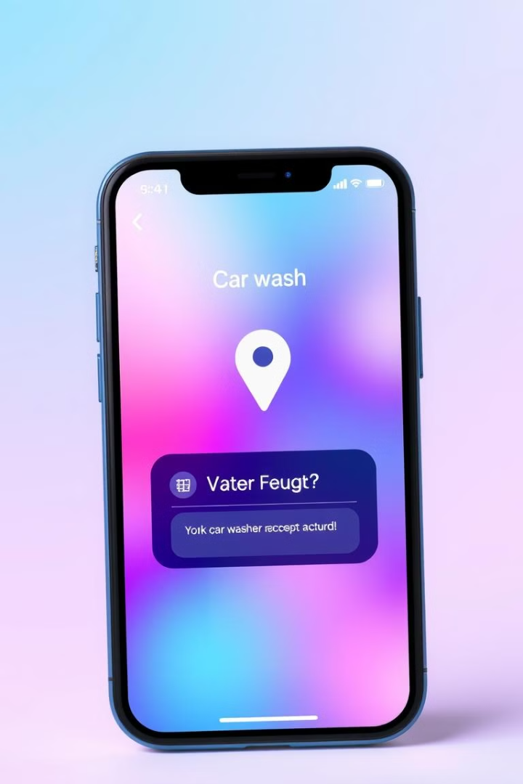
How it Works: Request, Accept, Wash
1
Request
Submit a car wash request through the ShineSquad app, specifying your location, car type, and desired services.
2
Accept
Available car washers in your area will receive your request and can choose to accept it.
3
Wash
The assigned car washer will arrive at your doorstep and provide a professional car wash, using quality cleaning materials.

Slide 5
Benefits for Car Owners
Time Savings
Convenience
Flexibility
No more long drives or waiting in line at car washes. Get your car cleaned while you go about your day.
Enjoy a stress-free car wash experience, with service delivered right to your doorstep.
Schedule your wash at your convenience, whether it's early morning, late evening, or even weekends.

Slide 6
Benefits for Car Washers
Earning Potential
Customer Base
Flexibility
Build your own car wash business, set your own hours, and earn competitive rates for your services.
Access a vast network of potential customers through the ShineSquad platform, expanding your reach.
Choose your working hours and take on as many car wash jobs as you desire, based on your availability.

Slide 7



Payment Options: Cash and UPI
Cash Payments
UPI Payments
For now, we offer convenient cash payment options, making transactions quick and easy for both parties.
We're working on implementing UPI payments to provide a secure and convenient digital payment option in the future.

Slide 8




Building the Car Washer Network
Onboarding
We are actively recruiting experienced and professional car washers to join our network, ensuring high-quality services.
Training
We provide training sessions to our car washers, focusing on best practices, customer service, and safety procedures.
Quality Control
We maintain stringent quality standards for our car wash services, monitoring customer feedback and performance.

Slide 9
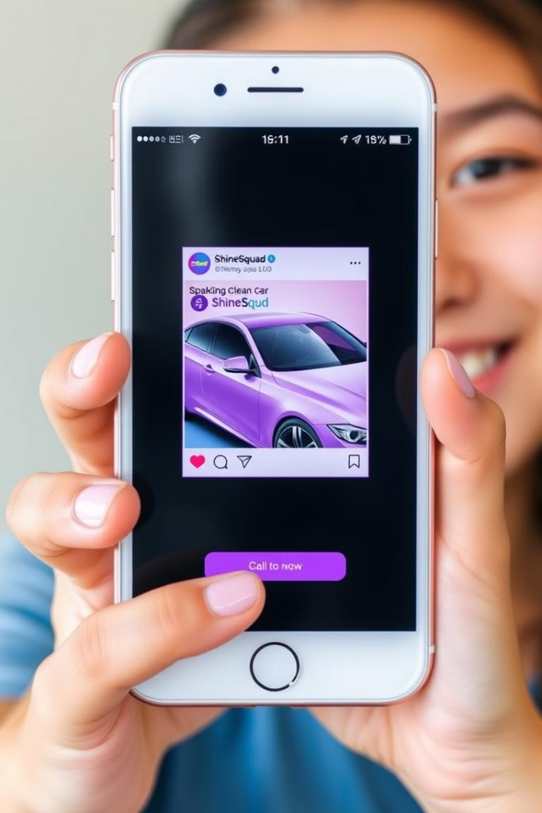
Marketing and Promotion Strategies
1
Social Media
2
Local Partnerships
Leveraging popular social media platforms to reach a wide audience, promote our services, and engage with potential customers.
Collaborating with local businesses, residential communities, and events to spread awareness and offer exclusive deals.
3
Referral Programs
4
Targeted Advertising
Encouraging existing customers to refer their friends and family, promoting word-of-mouth marketing.
Utilizing online advertising platforms to reach specific demographics and target potential customers based on their interests.

Slide 10

Future Expansion and Growth Plans
Expansion
We plan to expand our services to new cities and regions, bringing convenience and quality car washes to a wider audience.
Service Expansion
We are exploring additional services beyond car washes, such as interior detailing, upholstery cleaning, and paint protection.
Technology Integration
We are continuously improving our app, adding new features and functionalities to enhance the user experience and streamline operations.

Slide 11

Thank You for Choosing ShineSquad!
We appreciate your trust in our on-demand car washing service. Your satisfaction is our top priority, and we're committed to delivering exceptional results every time.

